Slide 1

IT5002
Computer Systems and Applications
Lecture 13
Process Scheduling
colintan@nus.edu.sg

Slide 2
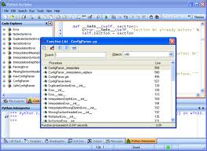

What does your Computer Spend its Time Doing?
A mix of jobs:
Computations + reading/writing memory.
Input/Output
Reading from the keyboard
Writing to the screen
Reading from the mouse
Sending/receiving data over the network.
Reading/writing the disk
…
How do we manage all these varied jobs?

Slide 3
The Scheduling Environment
Processes can be:
CPU bound
Most of the time spent on processing on CPU
Graphics-intensive applications are considered to be “CPU” bound.
Multitasking opportunities come from having to wait for processing results.
I/O bound
Most of the time is spent on communicating with I/O devices
Multitasking opportunities come from having to wait for data from I/O devices.

Slide 4
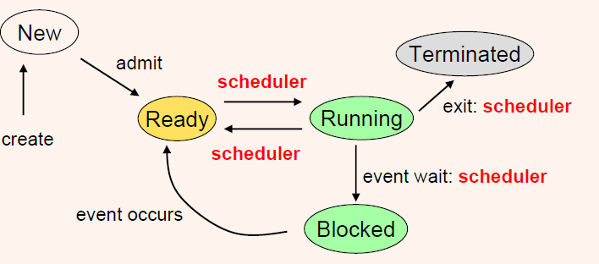
Process States
Processes switch between a fixed set of states depending on events that take place.
Scheduler is invoked at various points as shown below.

Slide 5
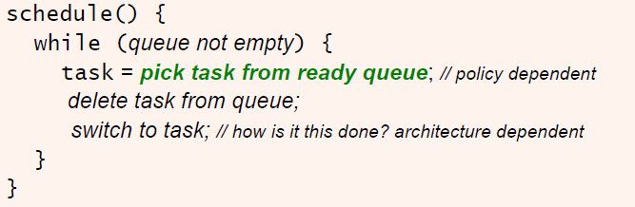
Generic Scheduler Algorithm
Question: How do we determine policies to pick the next task?

Slide 6
Types of Multitaskers
Policies are determined by the kind of multitasking environment.
Batch Processing
Not actually multitasking since only one process runs at a time to completion.
Co-operative Multitasking
Currently running processes cannot be suspended by the scheduler.
Processes must volunteer to give up CPU time.
Pre-emptive Multitasking
Currently running processes can be forcefully suspended by the scheduler.

Slide 7
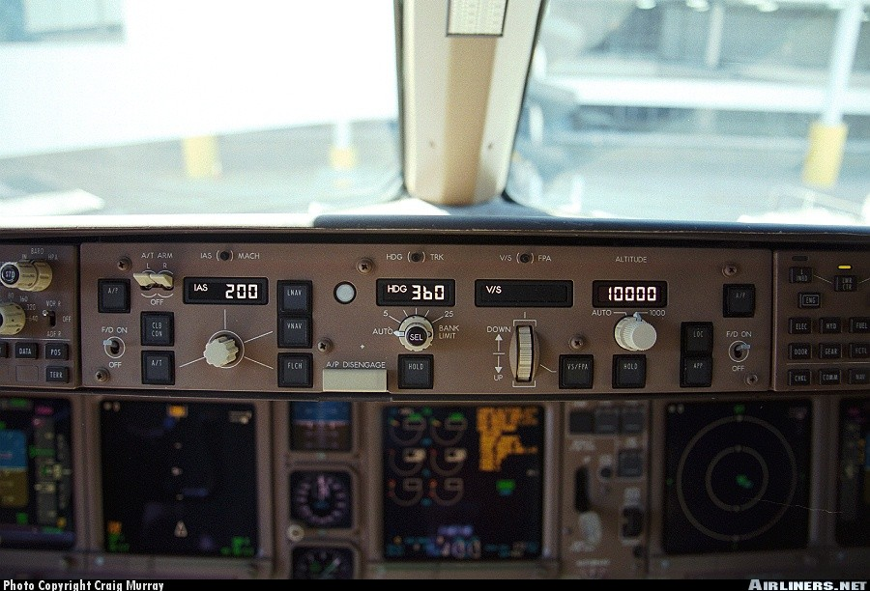
Types of Multitaskers
Real-Time Multitasking
Processes have fixed deadlines that must be met.
What if we don’t meet the deadlines?
Hard Real Time Systems: Disaster strikes! System fails, possibly catastrophically!
Soft Real Time Systems: Mostly just an inconvenience. Performance of system is degraded.

Slide 8
Scheduling Policies for Multitaskers
Scheduling Policies enforce a priority ordering over processes.
As mentioned earlier, determined by multitasking type.
Example Policies
Simplest Policy (Great for all types of multitaskers)
Fixed Priority
Policies for Batch Processing
First-come First Served (FCFS)
Shortest Job First (SJF)
Policies for Co-operative Multitaskers
Round Robin with Voluntary Scheduling (VS)

Slide 9
Scheduling Policies for Multitaskers
Example Policies
Policies for Pre-emptive Multitaskers
Round Robin with Timer (RR)
Shortest Remaining Time (SRT)
Policies for Real-Time Multitaskers (Not covered)
Rate Monotonic Scheduling (RMS)
Earliest Deadline First Scheduling (EDF)

Slide 10
Fixed Priority Policy
This is a simple policy that can be used across any type of multitasker.
Each task is assigned a priority by the programmer.
Usually priority number 0 has the highest priority.
Tasks are queued according to priority number.
Batch, Co-operative:
Task with highest priority is picked to be run next.
Pre-emptive, Real-Time:
When a higher priority task becomes ready, current task is suspended and higher priority task is run.

Slide 11
Batch Scheduling Policies
First Come First Served
Arriving jobs are stored in a queue.
Jobs are removed in turn and run.
Particularly suited for batch systems.
Extension for interactive systems:
Jobs removed for running are put back into the back of the queue.
This is also known as “round-robin scheduling”
Starvation free as long as earlier jobs are bounded.

Slide 12
Batch Scheduling Policies
Shortest Job First
Processes are ordered by total CPU time used.
Jobs that run for less time will run first.
Reduces average waiting time if number of processes is fixed.
Potential for starvation.

Slide 13
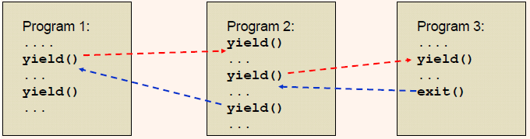
Co-operative Scheduling Policies
Voluntary Scheduling.
Processes call a special “yield” function.
This invokes the scheduler.
Causes the process to be suspended and another process started up.

Slide 14
Co-operative Scheduling Policies
In many systems VS is used with a round-robin arrangement.
yield()
yield()
Process 1
Process 2
Process 3
yield()

Slide 15
Pre-emptive Scheduling Policies
Shortest Remaining Time
Pre-emptive form of SJF.
Processes are ordered according to remaining CPU time left.
Round-robin with Timer
Each process is given a fixed time slot c_{i}.
After time c_{i}, scheduler is invoked and next task is selected on a round-robin basis.

Slide 16
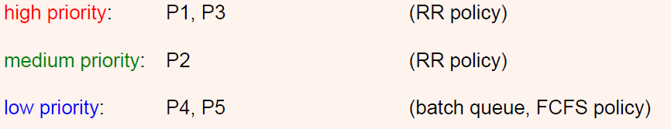
Managing Multiple Policies
Multiple policies can be implemented on the same machine using multiple queues:
Each queue can have its own policy.
This scheme is used in Linux, as we will see shortly.

Slide 17
Scheduling in Linux
Processes in Linux are dynamic:
New processes can be created with fork()
Existing processes can exit.
Priorities are also dynamic:
Users and superusers can change priorities using “nice” values.
nice –n 19 tar cvzf archive.tgz *
Allows tar to run with a priority lowered by 19 to reduce CPU load.
Normal users can only 0≤n≤19
Superusers can specify -20≤n≤19. Negative nice increases priority.

Slide 18
Scheduling in Linux
Linux maintains three types of processes:
Real-time FIFO:
RT-FIFO processes cannot be pre-empted except by a higher priority RT-FIFO process.
Real-time Round-Robin:
Like RT-FIFO but processes are pre-empted after a time slice.
Linux only has “soft real-time” scheduling.
Cannot guarantee deadlines, unlike RMS and EDF we saw earlier.
Priority levels 0 to 99
Non-real time processes
Priority levels 100 to 139

Slide 19
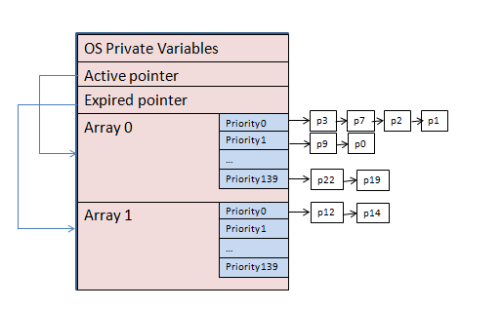
Scheduling in Linux
Linux maintains 280 queues in two sets of 140:
An active set.
An expired set.

Slide 20
Scheduling in Linux
The scheduler is called at a rate of 1000 Hz.
E.g. time tick is 1 ms, called a “jiffy”.
RT-FIFO processes are always run if any are available.
Otherwise:
Scheduler picks highest priority process in active set to run.
When its “time quantum” is expired, it is moved to the expired set. Next highest priority process is picked.
When active set is empty, active and expired pointers are swapped. Active set becomes expired set and vice versa.
Scheme ensures no starvation of lowest priority processes.

Slide 21
Scheduling in Linux
What happens if a process becomes blocked? (e.g. on I/O)
CPU time used so far is recorded. Process is moved to a queue of blocked processes.
When process becomes runnable again, it continues running until its time quantum is expired.
It is then moved to the expired set.
When a process becomes blocked its priority is often upgraded (see later).

Slide 22
Scheduling in Linux
Time quantums for RR processes:
Varies by priority. For example:
Priority level 100 – 800 ms
Priority level 139 – 5 ms
System load.
How process priorities are calculated:
Priority = base + f(nice)+g(cpu usage estimate)
f(.) = priority adjustment from nice value.
g(.) = Decay function. Processes that have already consumed a lot of CPU time are downgraded.

Slide 23
Scheduling in Linux
Other heuristics are used:
Age of process.
More priority for processes waiting for I/O – I/O boost.
Bias towards foreground tasks.
I/O Boost:
Rationale:
Tasks doing read() has been waiting for a long time. May need quick response when ready.
Blocked/waiting processes have not run much.
Applies also to interactive processes – blocked on keyboard/mouse input.

Slide 24
Scheduling in Linux
Implementation: We can -
Boost time quantum.
Boost priotiy.
Do both.
How long does this boost last?
Temporary boost for sporadic I/O
Permanent boost for the chronically I/O bound?
E.g. Linux gives -5 boost for interactive processes.

